Slide 1

Md Amjad Hossain
Base slides are prepared by from Suk Jin Lee

Slide 2
Overview
Quicksort
Sorts “in place”
Sorts O(n lg n) in the average case
Sorts O(n²) in the worst case
But in practice, it’s quick
And the worst case doesn’t happen often

Slide 3
Quicksort
Quicksort
Uses a Divide and conquer strategy
Sorts “in place” (cf. Mergesort needs extra space)
Very practical (with tuning)
The original problem partitioned into simpler subproblems
Each sub problem considered independently.
Unlike merge sort, no combining step: two subarrays form an already-sorted array

Slide 4
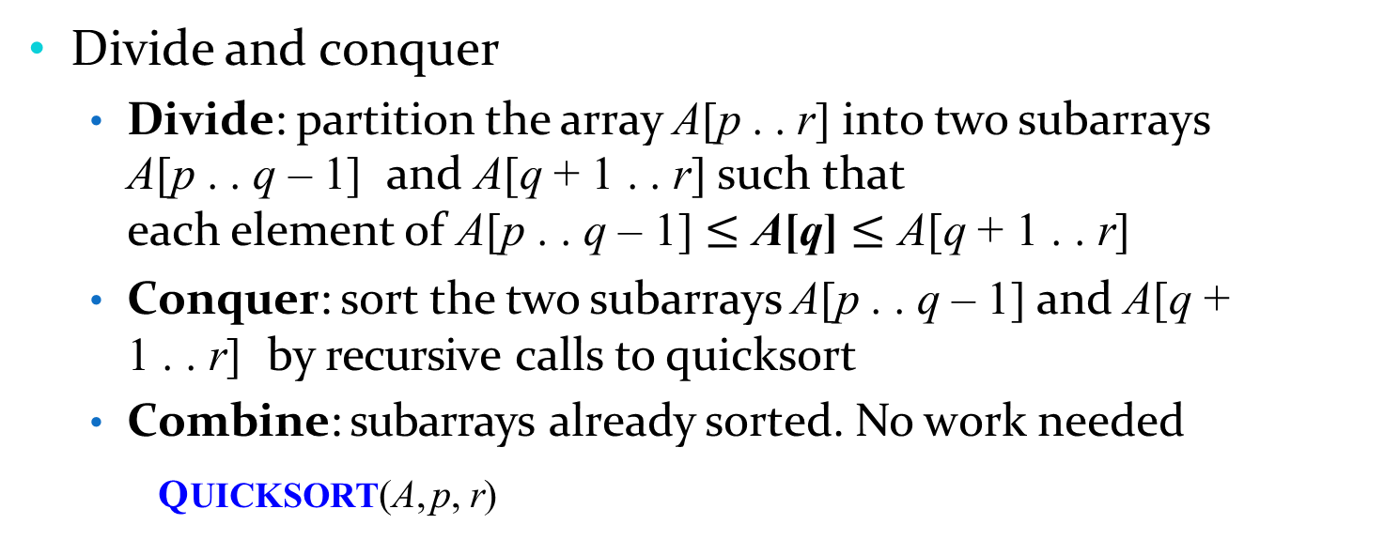
Quicksort
Divide and conquer
Divide: partition the array A[p . . r] into two subarrays
A[p . . q – 1] and A[q + 1 . . r] such that
each element of A[p . . q – 1] $≤$ A[q] $≤$ A[q + 1 . . r]
Conquer: sort the two subarrays A[p . . q – 1] and A[q +
1 . . r] by recursive calls to quicksort
Combine: subarrays already sorted. No work needed
QUICKSORT(A, p, r)
if p < r
q = PARTITION(A, p, r)
QUICKSORT(A, p, q – 1)
QUICKSORT(A, q + 1, r)
Initial call is QUICKSORT(A, 1, n)

Slide 5
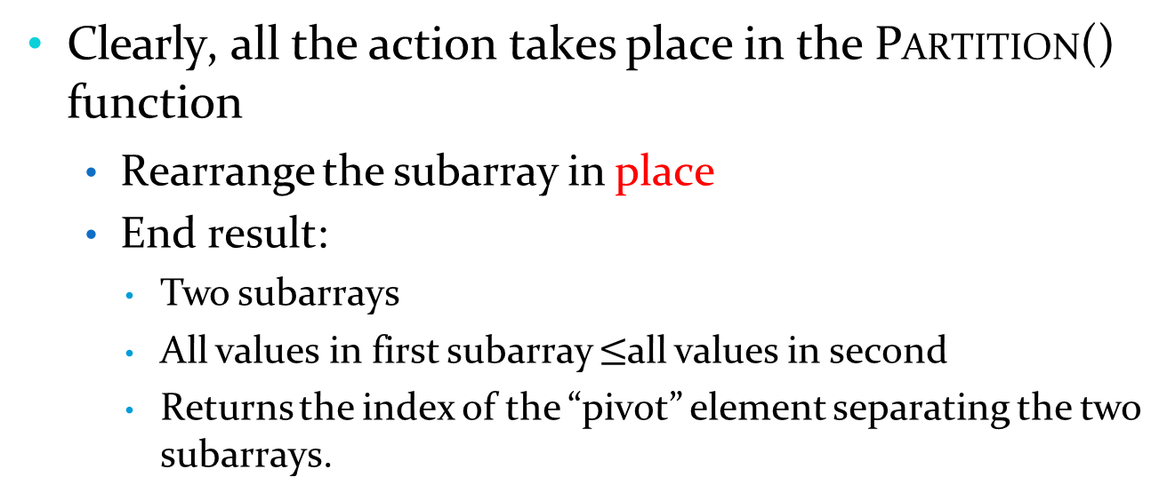
Partition
Clearly, all the action takes place in the PARTITION() function
Rearrange the subarray in place
End result:
Two subarrays
All values in first subarray $≤$all values in second
Returns the index of the “pivot” element separating the two subarrays.

Slide 6
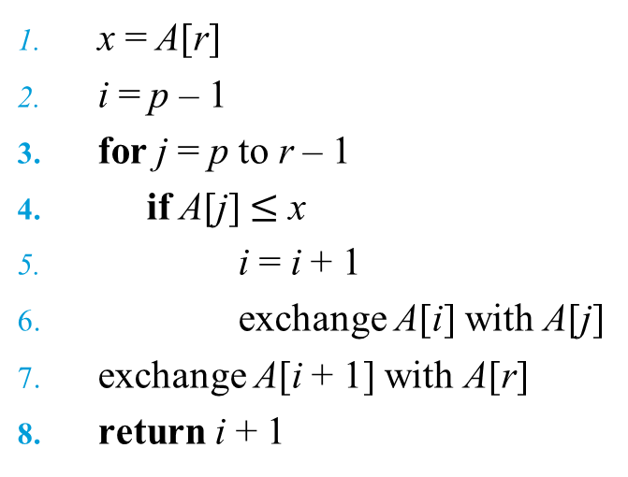
Partition
Partition procedure
PARTITION(A, p, r)
x = A[r]
i = p – 1
for j = p to r – 1
if A[j] $≤$ x
i = i + 1
exchange A[i] with A[j]
exchange A[i + 1] with A[r]
return i + 1
// select the last element in A[] as the pivot

Slide 7

Partition
Partition procedure
PARTITION(A, p, r)
x = A[r]
i = p – 1
for j = p to r – 1
if A[j] $≤$x
i = i + 1
exchange A[i] with A[j]
exchange A[i + 1] with A[r]
return i + 1
// select the last element in A[] as the pivot
What is the running time of Partition()?

Slide 8
Partition
Partition procedure
PARTITION(A, p, r)
x = A[r]
i = p – 1
for j = p to r – 1
if A[j] $≤$ x
i = i + 1
exchange A[i] with A[j]
exchange A[i + 1] with A[r]
return i + 1
// select the last element in A[] as the pivot
What is the running time of Partition()?
PARTITION() runs in Θ(n)

Slide 9
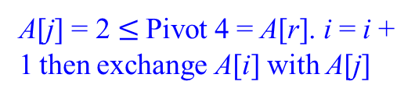
Quicksort
Operation of Partition
i p j
r
2 | 8 | 7 | 1 | 3 | 5 | 6 | 4
A[j] = 2 $≤$Pivot 4 = A[r]. i = i + 1 then exchange A[i] with A[j]
p i j
r
2 | 8 | 7 | 1 | 3 | 5 | 6 | 4
A[j] > Pivot 4, no increase of i
p i
j
r
2 | 8 | 7 | 1 | 3 | 5 | 6 | 4
A[j] > Pivot 4, no increase of i

Slide 10
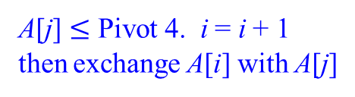
Quicksort
Operation of Partition
p i j
r
2 | 8 | 7 | 1 | 3 | 5 | 6 | 4
A[j] $≤$ Pivot 4. i = i + 1 then exchange A[i] with A[j]
p i
j
r
2 | 1 | 7 | 8 | 3 | 5 | 6 | 4
A[j] $≤$ Pivot 4. i = i + 1 then exchange A[i] with A[j]
p
i
j
r
2 | 1 | 3 | 8 | 7 | 5 | 6 | 4
A[j] > Pivot 4, no increase of i

Slide 11
Quicksort
Operation of Partition
p i j r
A[j] > Pivot 4, no increase of i
2 | 1 | 3 | 8 | 7 | 5 | 6 | 4
p
i
r
2 | 1 | 3 | 8 | 7 | 5 | 6 | 4
j > r – 1, escape the Loop Exchange A[i + 1] with A[r]
p
i
r
2 | 1 | 3 | 4 | 7 | 5 | 6 | 8
The pivot lies between the two partitions

Slide 12


Quicksort
Four regions maintained by the procedure PARTITION on a subarray A[p … r]
p
i
j
r
 |  |  |  |  |  |  |  |  |  |  |  |  | x
$≤$x
$≥$x
unrestricted
The running time of PARTITION on subarray A[p . . r] is Θ(n)

Slide 13
Quiz 1
Using the previous figure model, illustrate the operation of PARTITION on the array
A = (13, 19, 9, 5, 12, 8, 7, 4, 21, 2, 6, 11)

Slide 14
Prepared by Suk Jin Lee

Slide 15
Quicksort Analysis
What will be the worst case for the algorithm?
Partition is always unbalanced
- Array is already sorted
What will be the best case for the algorithm?
Partition is perfectly balanced
Which is more likely?
The latter

Slide 16
Worst-case partitioning
Worst-case partitioning
Produces one subproblem with n – 1 elements and one with 0 elements
T(n) = T(n – 1) + T(0) + Θ(n) // Θ(n): partitioning cost
T(n)
Partitioning costs Θ(n)
T(0)
T(n – 1)
T(0)
T(n – 2)
T(0)
...
T(0)

Slide 17
Worst-case partitioning
Worst-case partitioning
Produces one subproblem with n – 1 elements and one with 0 elements
T(n) = T(n – 1) + T(0) + Θ(n) // 0(n): partitioning cost
= T(n – 1) + Θ(n) // T(0) = Θ(1)
= T(n – 2) + Θ(n) + Θ(n) = T(n – 2) + 2× Θ(n)
……
= T(n – k) + Θ(n) + (k – 1)× Θ(n) = T(n – k) + k× Θ(n)
= T(n-n) + n× Θ(n)
= Θ(n²)

Slide 18
Worst-case partitioning
Worst-case partitioning
Produces one subproblem with n – 1 elements and one with 0 elements
= T(n – 1) + T(0) + Θ(n) // Θ(n): partitioning cost
= Θ(n²)
Same running time as insertion sort
In fact, the worst-case running time occur when quicksort takes a sorted array as input, but insertion sort runs in O(n) time in this case
T(n)

Slide 19
Best-case partitioning
Best-case partitioning
If we’re really lucky, produces two subproblem each with n/2
T(n) = 2T(n / 2) + Θ(n) , Θ(n): partitioning cost

Slide 20
Best-case partitioning
Best-case partitioning
If we’re really lucky, produces two subproblem each with n/2
T(n) = 2T(n / 2) + Θ(n) , Θ(n): partitioning cost
Using master theorem
a = 2, b = 2, f(n) = Θ(n)
f (n) = Θ(n^{logb a} )= Θ(n^{log2 2} )= Θ(n)
Case 2 applies: T (n) = Θ(n^{log2 2} lg n)= Θ(n lg n)
To solve the equation,
check the page 102-103 of the textbook.
Also: https://www.programiz.com/dsa/master-theorem
More details: https://www.geeksforgeeks.org/advanced-master-theorem-for-divide-and-conquer-recurrences/

Slide 21
Best-case partitioning
Best-case partitioning
If we’re really lucky, produces two subproblem each with n/2
T(n)
= 2T(n / 2) + Θ(n) , Θ(n): partitioning cost
= Θ(n lg n)
By equally balancing the two sides of the partition at every level of the recursion, we get an asymptotically faster algorithm

Slide 22
Balanced partitioning
Balanced partitioning
Quicksort’s average running time is much closer to the best case than to the worst case
Imagine that PARTITION always produces a 9-to-1 split
We obtain the recurrence:
T(n) = T(9n / 10) + T(n / 10) + Θ(n)

Slide 23





Balanced partitioning
Balanced partitioning
What if the split is always 9-to-1?
T(n) = T(9n / 10) + T(n / 10) + Θ(n)
$$\log_{10}{N}= \frac{\log_{2}{N}}{\log_{2}{10}​}$$
$\log_{10}{N}$is a constant multiple of $\log_{2}{N}$
cn
cn
$$\log_{10}{N=Θ(\log_{2}{N})}$$
1 _{cn}
10
9 _{cn}
10
$$\log_{10/9}{N}=Θ(\log_{2}{N})$$
cn
log₁₀n
log_{10/9}n
1 _{cn}
100
9 _{cn} 9 _{cn}
100 100
81 _{cn}
100
cn
...
Θ(1)
...
... ...
O(n) leaves
::: cn
Θ(1)
cnlog₁₀n $≤$ T(n) $≤$cnlog_{10/9}n = O(nlogn)

Slide 24
Intuition for the average case
Intuition for the average case
Splits in the recursion tree will not always be constant
There will usually be a mix of good and bad splits throughout the recursion tree
To see that this doesn’t affect the asymptotic running time of quicksort, assume that levels alternate between best-case (good) and worst-case (bad) splits

Slide 25
Intuition for the average case
Intuition for the average case
Two levels of a recursion tree for quicksort
Partitioning cost: Θ(n) + Θ(n – 1) = Θ(n)
Bad split
n
0(n)
Good split
0
n – 1
(n −1) ₋₁
2
(n −1)
2

Slide 26
Intuition for the average case
Intuition for the average case
A single level of a recursion tree for quicksort
Partitioning cost: Θ(n)
n
0(n)
(n −1)
2
(n −1)
2
Very well balanced

Slide 27

Intuition for the average case
Suppose we alternate lucky, unlucky, lucky, unlucky, lucky, ….
lucky unlucky
L(n) = 2U(n/2) + Θ(n)
U(n) = L(n –1) + Θ(n)
Solving:
L(n) = 2(L(n/2 – 1) + Θ(n/2)) + Θ(n)
= 2L(n/2 – 1) + Θ(n) similar to best case;
= Θ(n lg n)
: Master theorem case 2 applies
How can we make sure we are usually lucky?

Slide 28
Quiz 2 (1)
Use the substitution method to prove that the recurrence T(n) = T(n – 1) + Θ(n) has the solution T(n) = 0(n²)

Slide 29
Quiz 2 (2)
Use the substitution method to prove that the recurrence T(n) = T(n – 1) + Θ(n) has the solution T(n) = Θ(n²)
We guess that T(n) :. O(n²)
T(n)
:: c₁(n – 1)² + Θ(n)
:: c₁(n – 1)² + c₀n
:: c₁n² – (2c₁ – c₀)n + c₁
:: c₁n² for n₀ ζ 1 and c₀ > c₁
Thus T(n) Ε O(n²). Similarly, we can prove that T(n) Ε Θ(n²).

Slide 30
Quiz 3 (1)
What is the running time of Quicksort when all elements of array A have the same value?

Slide 31
Quiz 3 (2)
What is the running time of Quicksort when all elements of array A have the same value?
If all elements are the same, the quick sort partition return index q = r.
The problem with size n is reduced to one sub-problem with size n – 1:
T(n) = T(n – 1) + Θ(n), Θ(n) is a partitioning cost

Slide 32

Prepared by Suk Jin Lee

Slide 33
Randomized Quicksort
Randomized version of quicksort
We have assumed that all input permutations are equally likely.
This is not always true.
To correct this, we add randomization to quicksort.

Slide 34
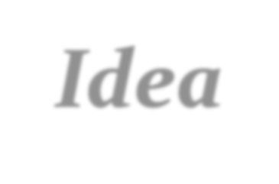

Randomized Quicksort
Idea: instead of always A[r] as the pivot, we will select a randomly chosen element from the subarray A[p . . r]
Running time is independent of the input order.
No assumptions need to be made about the input distribution.
No specific input elicits the worst-case behavior.
The worst case is determined only by the output of a random-number generator.

Slide 35
Randomized Quicksort
Randomized-Partition(A, p, r)
i = RANDOM(p, r)
exchange A[r] with A[i]
return Partition(A, p, r)
Randomly selecting the pivot element will, on average, cause the split of the input array to be reasonably well balanced
Randomized-Quicksort(A, p, r)
1. if p < r
q = Randomized-Partition(A, p, r) Randomized-Quicksort(A, p, q – 1) Randomized-Quicksort(A, q + 1, r)
2.
3.
4.

Slide 36

Prepared by Suk Jin Lee

Slide 37
Analysis of Quicksort: Average Case
For simplicity, assume:
All inputs distinct (no repeats)
Slightly different PARTITION() procedure
Partition around a random element, which is not included in subarrays
All splits (0:n-1, 1:n-2, 2:n-3, … , n-1:0) equally likely

Slide 38
Analysis of Quicksort: Average Case
For simplicity, assume:
All inputs distinct (no repeats)
Slightly different PARTITION() procedure
Partition around a random element, which is not included in subarrays
All splits (0:n-1, 1:n-2, 2:n-3, … , n-1:0) equally likely
What is the probability of a particular split happening?
Answer: 1/n

Slide 39
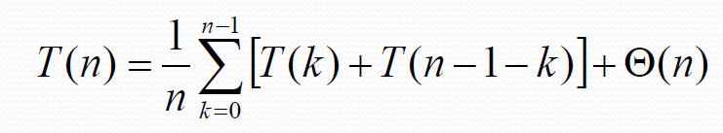
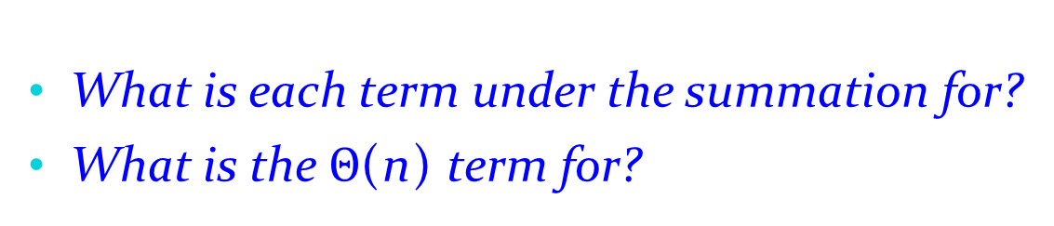
Analysis of Quicksort: Average Case
So partition generates splits
(0:n-1, 1:n-2, 2:n-3, … , n-1:0)
each with probability 1/n
If T(n) is the expected running time
What is each term under the summation for?
What is the $Θ$(n) term for?

Slide 40
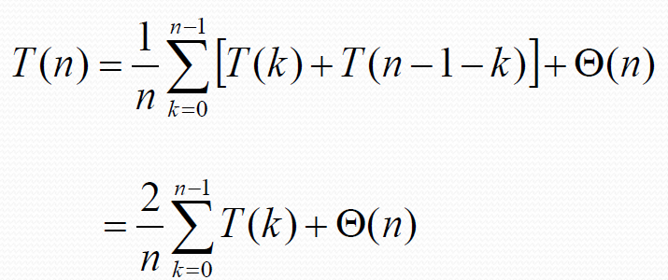
Analysis of Quicksort: Average Case
So…
Note: this is just like the recurrence expect that the summation starts with k = 0

Slide 41
Analysis of Quicksort: Average Case
We can solve this recurrence using the substitution method
Guess the answer
Assume that the inductive hypothesis holds
Substitute it in for some value < n
Prove that it follows for n

Slide 42
Analysis of Quicksort: Average Case
We can solve this recurrence using the substitution method
Guess the answer
What’s the answer?
Assume that the inductive hypothesis holds
Substitute it in for some value < n
Prove that it follows for n

Slide 43
Analysis of Quicksort: Average Case
We can solve this recurrence using the substitution method
Guess the answer
T(n) = O(n lg n)
Assume that the inductive hypothesis holds
Substitute it in for some value < n
Prove that it follows for n

Slide 44
Analysis of Quicksort: Average Case
We can solve this recurrence using the substitution method
Guess the answer
T(n) = O(n lg n)
Assume that the inductive hypothesis holds
What’s the inductive hypothesis?
Substitute it in for some value < n
Prove that it follows for n

Slide 45
Analysis of Quicksort: Average Case
We can solve this recurrence using the substitution method
Guess the answer
T(n) = O(n lg n)
Assume that the inductive hypothesis holds
T(n) :: an lg n + b for some constant a and b
Substitute it in for some value < n
Prove that it follows for n

Slide 46
Analysis of Quicksort: Average Case
We can solve this recurrence using the substitution method
Guess the answer
T(n) = O(n lg n)
Assume that the inductive hypothesis holds
T(n) :: an lg n + b for some constant a and b
Substitute it in for some value < n
What value?
Prove that it follows for n

Slide 47
Analysis of Quicksort: Average Case
We can solve this recurrence using the substitution method
Guess the answer
T(n) = O(n lg n)
Assume that the inductive hypothesis holds
T(n) :: an lg n + b for some constant a and b
Substitute it in for some value < n
The value k in the recurrence
Prove that it follows for n

Slide 48
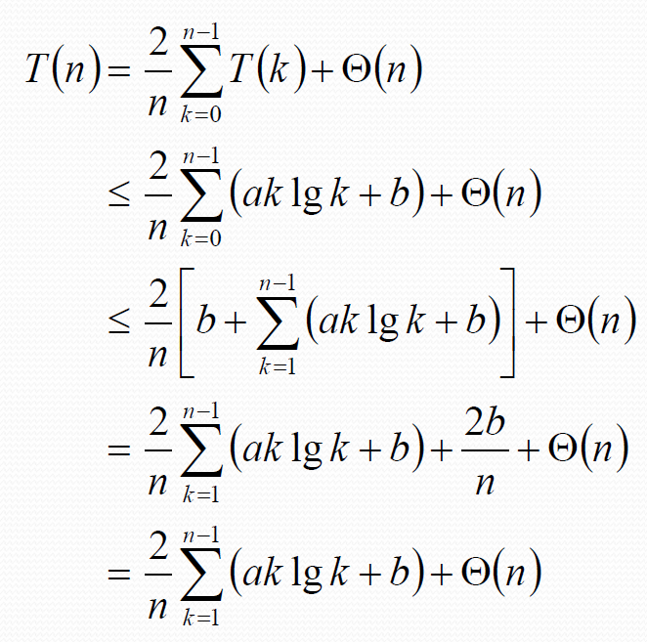
Analysis of Quicksort: Average Case
The recurrence to be solved
Plug in inductive hypothesis
Expand out the k = 0 case
2b/n is just a constant, so fold it into 0(n)
Note: leaving the recurrence

Slide 49
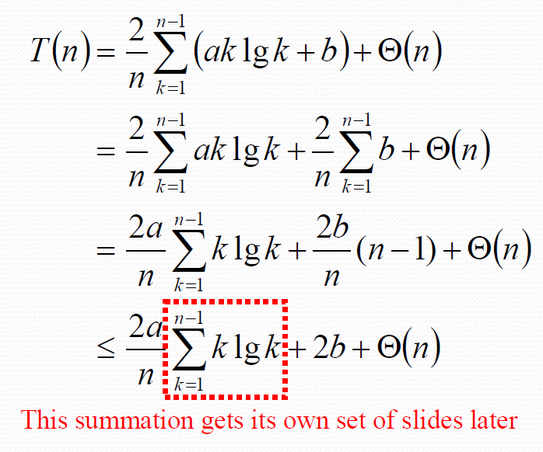
Analysis of Quicksort: Average Case
The recurrence to be solved
Distribute the summation
Evaluate the summation:
b + b +…+ b = b (n − 1)
Since n − 1 < n, 2b(n − 1)/n < 2b

Slide 50
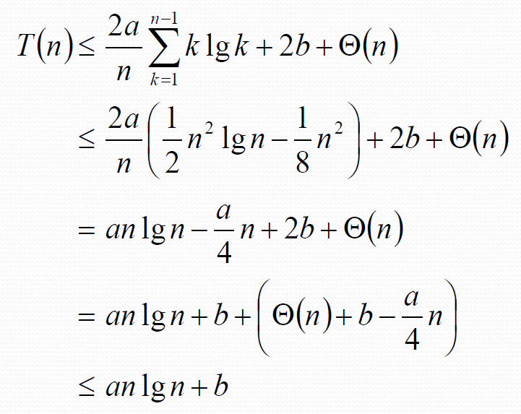
Analysis of Quicksort: Average Case
The recurrence to be solved
We’ll prove this later
Distribute the (2a/n) term
Remember, our goal is to get T(n) ::: an lg n + b
Pick a large enough that
an/4 dominates 0(n)+b

Slide 51
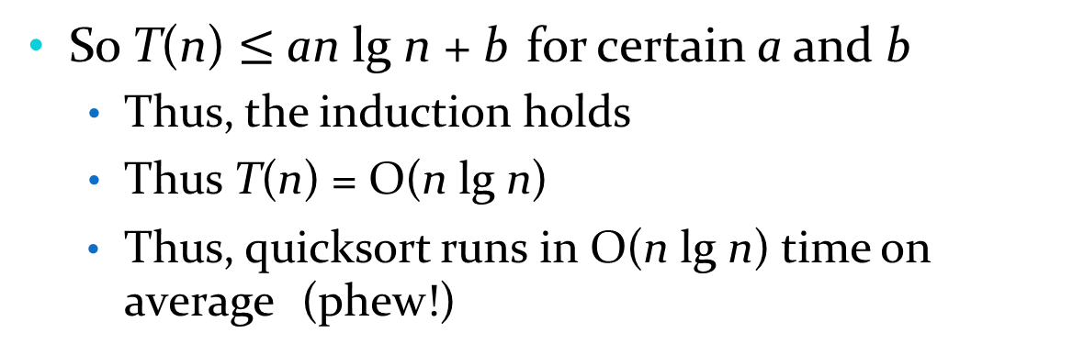
Analysis of Quicksort: Average Case
So T(n) $≤$ an lg n + b for certain a and b
Thus, the induction holds
Thus T(n) = O(n lg n)
Thus, quicksort runs in O(n lg n) time on average (phew!)

Slide 52
Quicksort in practice
Quicksort is a great general-purpose sorting algorithm.
Quicksort(in-place) is typically over twice as fast as merge sort(not in place).
Quicksort can benefit substantially from code tuning.
Quicksort behaves well even with caching and virtual memory.

